Slide 1
18CSC311: MACHINE LEARNING Lecture 2
References: Towards data science, Machine Learning Mastery, Textbooks as per the syllabus

Slide 2
Evaluation Metrics

Slide 3
Evaluation Metrics
Evaluation metrics explain the performance of a model.
The evaluation metrics used in each of these models are different.
Predictive Models
Classification
Regression
https://iq.opengenus.org/performance-metrics-in-classification-regression/

Slide 4
Evaluation Metrics
Regression
Classification
Mean Absolute Error (MAE)
Mean Squared Error (MSE)
Root Mean Squared Error (RMSE)
R-Squared
Adjusted R-squared
Accuracy
Precision and Recall
Specificity
F1-score
AUC-ROC

Slide 5
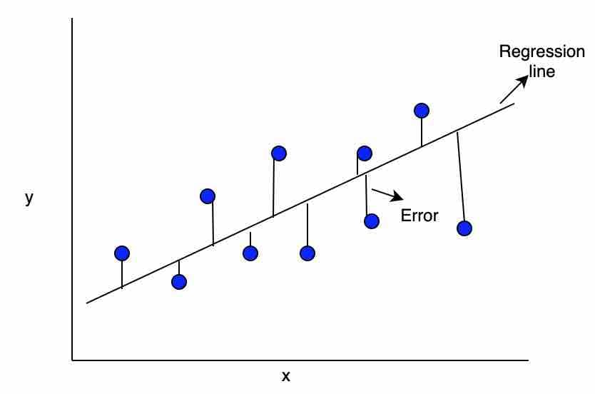
Regression

Slide 6
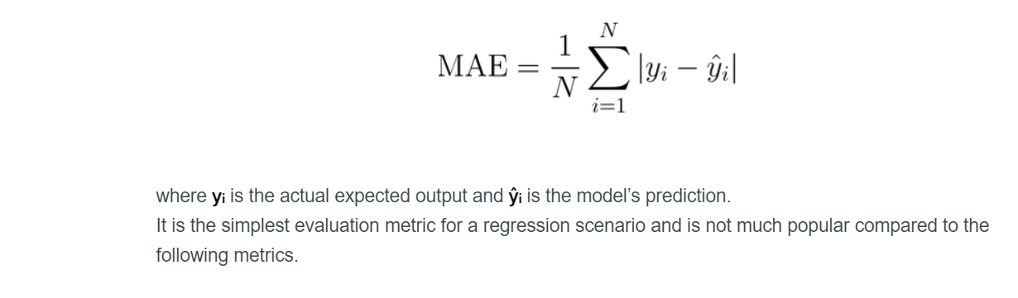
Regression-Evaluation Metrics
Mean Absolute Error (MAE)
where yᵢ is the actual expected output and ŷᵢ is the model’s prediction.
It is the simplest evaluation metric for a regression scenario and is not much popular compared to other metrics.
yᵢ = [5,10,15,20] and
ŷᵢ = [4.8,10.6,14.3,20.1]
Calculate MAE
MAE = 1/4 * (|5-4.8|+|10-10.6|+|15-14.3|+|20-20.1|) = 0.4
https://iq.opengenus.org/performance-metrics-in-classification-regression/

Slide 7
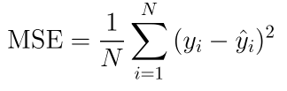
Regression-Evaluation Metrics
Mean Squared Error (MSE)
the error term is squared and thus more sensitive to outliers as compared to Mean Absolute Error (MAE).
yᵢ = [5,10,15,20] and
ŷᵢ = [4.8,10.6,14.3,20.1]
Calculate MSE
MSE = 1/4 * (|5-4.8|^2+|10-10.6|^2+|15-14.3|^2+|20-20.1|^2) = 0.225

Slide 8
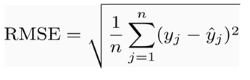
Regression-Evaluation Metrics
Root Mean Squared Error (RMSE)
Since MSE includes squared error terms, we take the square root of the MSE, which gives rise to Root Mean Squared Error (RMSE).
yᵢ = [5,10,15,20] and
ŷᵢ = [4.8,10.6,14.3,20.1]
Calculate RMSE
MSE = 1/4 * (|5-4.8|^2+|10-10.6|^2+|15-14.3|^2+|20-20.1|^2) = 0.225
RMSE = (0.225)^0.5 = 0.474

Slide 9
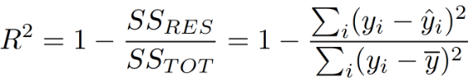
Regression-Evaluation Metrics
R-Squared
R-squared is calculated by dividing the sum of squares of residuals (SSres) from the regression model by the total sum of squares (SStot) of errors from the average model and then subtract it from 1.
A R-squared value of 0.81, tells that the input variables explains 81 % of the variation in the output variable.
The higher the R squared, the more variation is explained by the input variables and better is the model.

Slide 10
Classification-Evaluation Metrics
Confusion Matrix
A confusion matrix is an N X N matrix, where N is the number of classes being predicted.
Table that describes the performance of a classification model by grouping predictions into 4 categories.
Example:
True Positives: we correctly predicted they do have diabetes
True Negatives: we correctly predicted they don’t have diabetes
False Positives: we incorrectly predicted they do have diabetes (Type I error)
False Negatives: we incorrectly predicted they don’t have diabetes (Type II error)

Slide 11
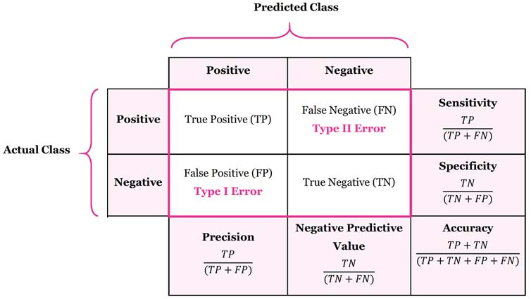
Classification-Evaluation Metrics

Slide 12

Classification-Evaluation Metrics
Accuracy
Accuracy is defined as the ratio of the number of correct predictions and the total number of predictions.
It lies between [0,1]. In general, higher accuracy means a better model (TP and TN must be high).
Accuracy is not a useful metric in case of an imbalanced dataset (datasets with uneven distribution of classes).

Slide 13
Classification-Evaluation Metrics
Accuracy
Consider the following values for the confusion matrix-
True negatives (TN) = 300
True positives (TP) = 500
False negatives (FN) = 150
False positives (FP) = 50
What is the accuracy?
(500+300)/(500+50+150+300) = 800/1000 = 80%

Slide 14
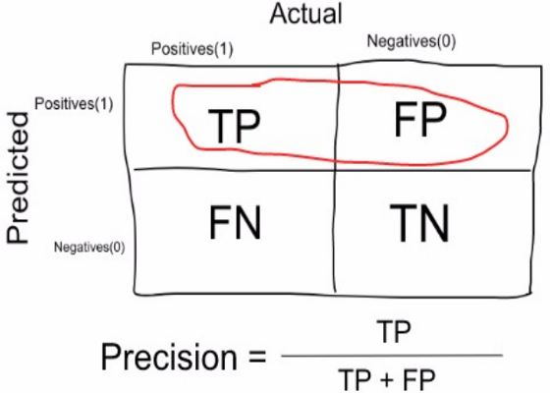
Precision
It is the number of correct positive results divided by the number of positive results predicted by the classifier
Precision is a measure that tells us what proportion of patients that we diagnosed as having cancer, actually had cancer
The predicted positives (People predicted as cancerous are TP and FP) and the people actually having a cancer are TP.
Ex: In our cancer example with 100 people, only 5 people have cancer. Let’s say our model is very bad and predicts every case as Cancer.
Since we are predicting everyone as having cancer, our denominator(True positives and False Positives) is 100 and the numerator, person having cancer and the model predicting his case as cancer is 5.
So in this example, we can say that Precision of such model is 5%.

Slide 15
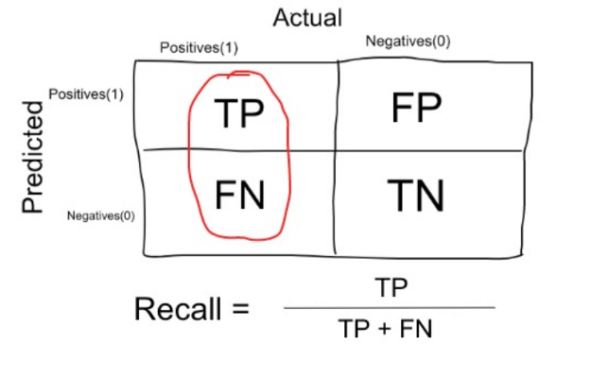
Recall or Sensitivity
True Positive Rate corresponds to the proportion of positive data points that are correctly considered as positive, with respect to all positive data points.
Recall is a measure that tells us what proportion of patients that actually had cancer was diagnosed by the algorithm as having cancer.
The actual positives (People having cancer are TP and FN) and the people diagnosed by the model having a cancer are TP.
In our cancer example with 100 people, 5 people actually have cancer. Let’s say that the model predicts every case as cancer
So our denominator(True positives and False Negatives) is 5 and the numerator, person having cancer and the model predicting his case as cancer is also 5(Since we predicted 5 cancer cases correctly).
So in this example, we can say that the Recall of such model is 100%.

Slide 16
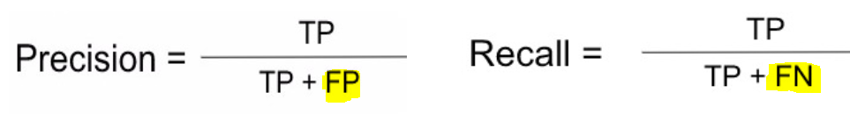
Classification-Evaluation Metrics
Precision
Precision is useful when we want to reduce the number of False Positives.
Consider a system that predicts whether the e-mail received is spam or not. Taking spam as a positive class, we do not want our system to predict non-spam e-mails (important e-mails) as spam, i.e., the aim is to reduce the number of False Positives.
Calculate Precision for the above values:
500/(500+50) = 500/550 = 90.90%

Slide 17
Classification-Evaluation Metrics
Recall
Recall is useful where we want to minimize the number of False negatives
Consider the case of cancer detection. we don't want our model to mark a patient suffering from cancer as safe. On the other hand, predicting a healthy patient as cancerous is not a big issue since, in further diagnosis, it will be cleared that he does not have cancer. Recall is also known as Sensitivity.
Calculate Recall for the above values:
500/(500+150) = 500/650 = 76.92%

Slide 18
When to use Precision and When to use Recall?
Recall gives us information about a classifier’s performance with respect to false negatives (how many did we miss)
Focus more on minimising False Negatives, we would want our Recall to be as close to 100% as possible
Precision gives us information about its performance with respect to false positives(how many did we caught)
If we want to focus on minimising False positives, then our focus should be to make Precision as close to 100% as possible

Slide 19

Classification-Evaluation Metrics
Specificity
Specificity is defined as the ratio of True negatives and True negatives + False positives. We want the value of specificity to be high. Its value lies between [0,1].
Calculate specificity for the above values:
300/(300+50) = 300/350 = 85.71%

Slide 20

Classification-Evaluation Metrics
F1 Score
F1-score is a metric that combines both Precision and Recall and equals to the harmonic mean of precision and recall. Its value lies between [0,1] (more the value better the F1-score).
Calculate F1 score for the above values:
precision=0.9090 and recall=0.7692, F1-score = 0.8333 = 83.33%

Slide 21
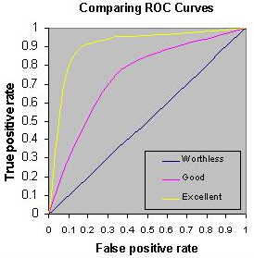
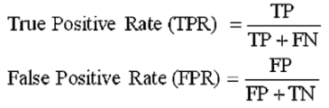
Classification-Evaluation Metrics
ROC (Receiver Operating Characteristics)
An ROC curve (receiver operating characteristic curve) is a graph showing the performance of a classification model at all classification thresholds. This curve plots two parameters:
True Positive Rate
False Positive Rate
An ROC curve plots TPR vs. FPR at different classification thresholds. Lowering the classification threshold classifies more items as positive, thus increasing both False Positives and True Positives.

Slide 22
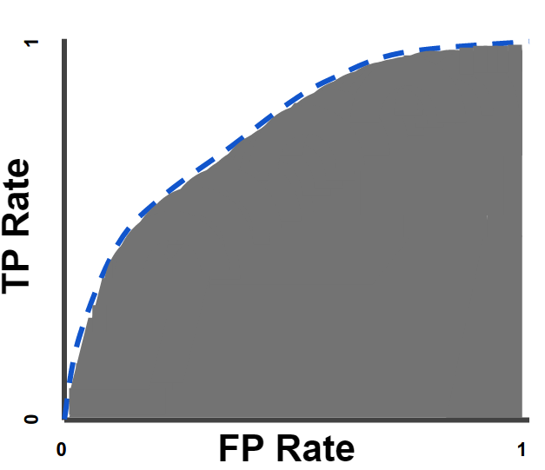
Classification-Evaluation Metrics
AUC: Area Under the ROC Curve
AUC measures the entire two-dimensional area underneath the entire ROC curve (think integral calculus) from (0,0) to (1,1).
AUC provides an aggregate measure of performance across all possible classification thresholds.

Slide 23
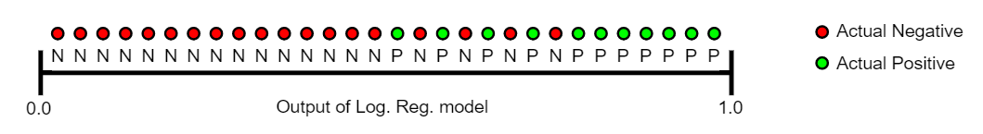
Classification-Evaluation Metrics
AUC: Area Under the ROC Curve
AUC can be considered as the probability that the model ranks a random positive example more highly than a random negative example.
Given the following examples, which are arranged from left to right in ascending order of logistic regression predictions:
AUC represents the probability that a random positive (green) example is positioned to the right of a random negative (red) example.
A model whose predictions are 100% wrong has an AUC of 0.0;
one whose predictions are 100% correct has an AUC of 1.0.

Slide 24
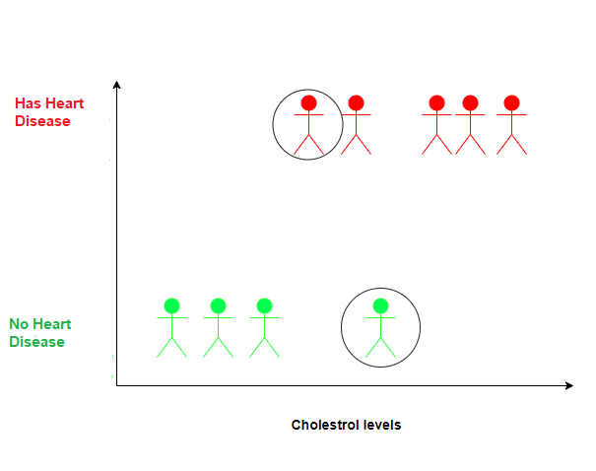
Classification-Evaluation Metrics
Understanding AUC: Use Case
Consider a hypothetical example containing a group of people.
Y-axis has two categories: i.e Has Heart Disease represented by red people and does not have Heart Disease represented by green circles.
X-axis : cholesterol levels and the classifier tries to classify people into two categories depending upon their cholesterol levels.
Circled Red person has low cholesterol levels still had a heart attack. This may be due to the reason that he has other heart-related issues.
Circled Green person has a high level of cholesterol but does not have heart disease. This may be due to the reason that now the person is observing a better lifestyle and exercising regularly.
https://towardsdatascience.com/understanding-the-roc-and-auc-curves-a05b68550b69

Slide 25
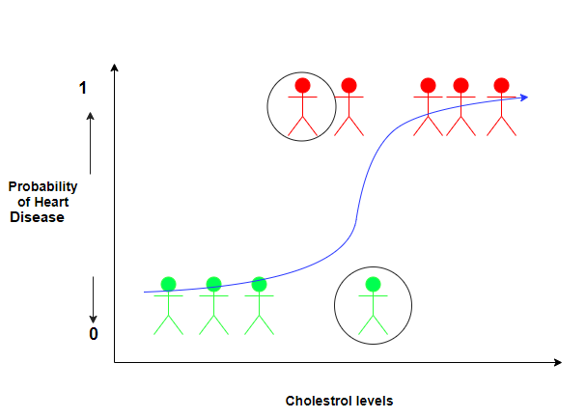
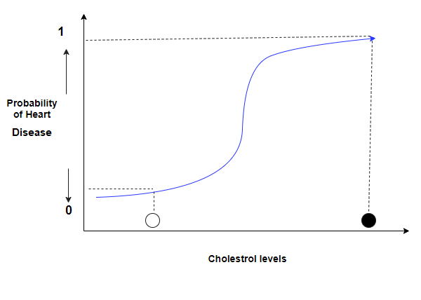
Understanding AUC: Use Case
Logistic Regression curve
The white dot represents a person having a lower heart disease probability than the person represented by the black dot.

Slide 26
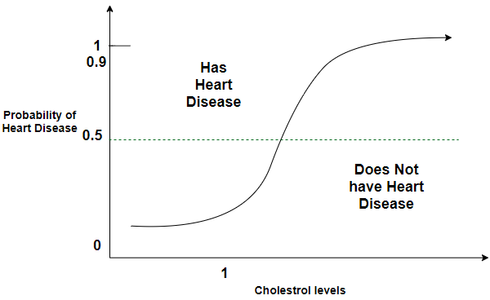
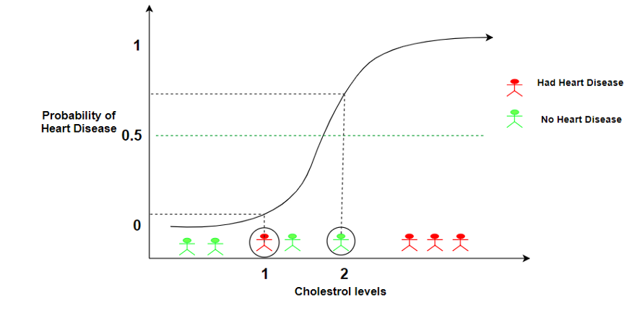
Understanding AUC: Use Case
Use different thresholds to classify the people in to either of two categories.
Threshold=0.5
Classify the people who have a probability of heart disease > 0.5 as “having a heart disease” and classify the people who have a probability of heart disease < 0.5 as “ not having a heart disease”.

Slide 27

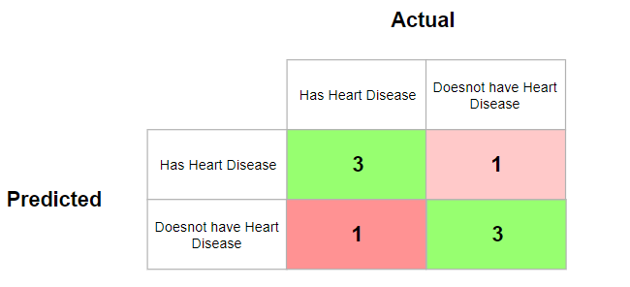
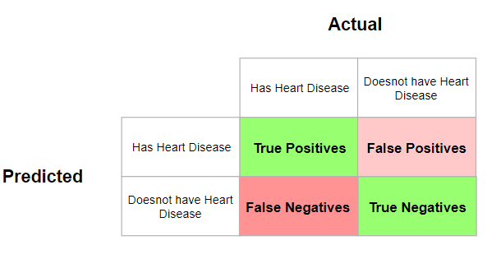
Understanding AUC: Use Case
Threshold=0.5

Slide 28
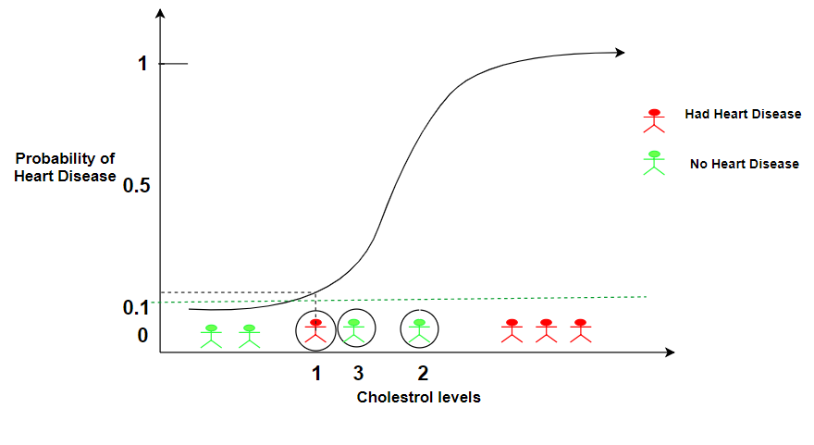
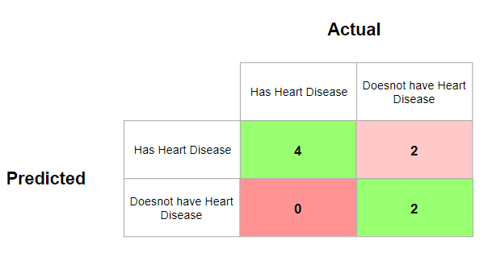
Understanding AUC: Use Case – Setting the Threshold to 0.1
Therefore a lower threshold:
Increases the number of False Positives
Decreases the number of False Negatives

Slide 29
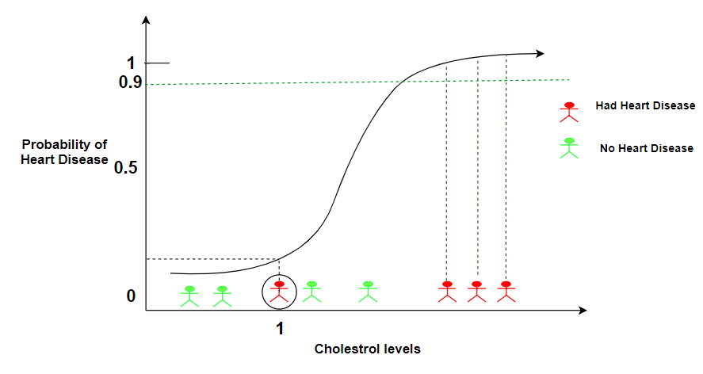
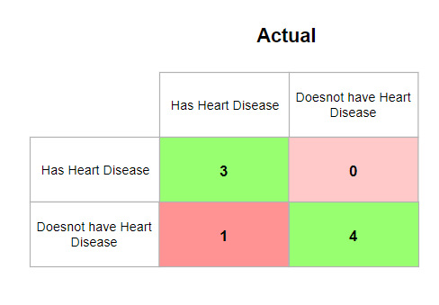
Understanding AUC: Use Case – Setting the Threshold to 0.9
Therefore a higher threshold:
Decreases the number of False Positives
Increases the number of False Negatives.

Slide 30
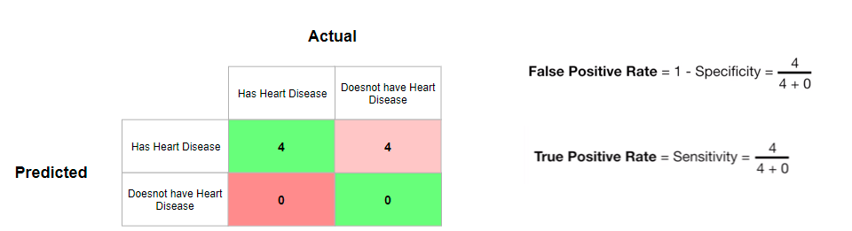
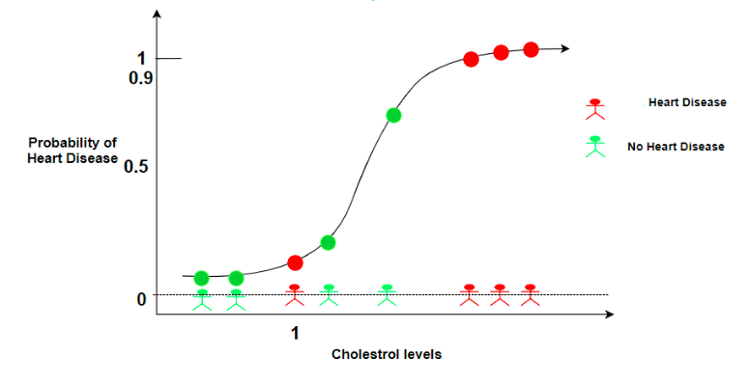
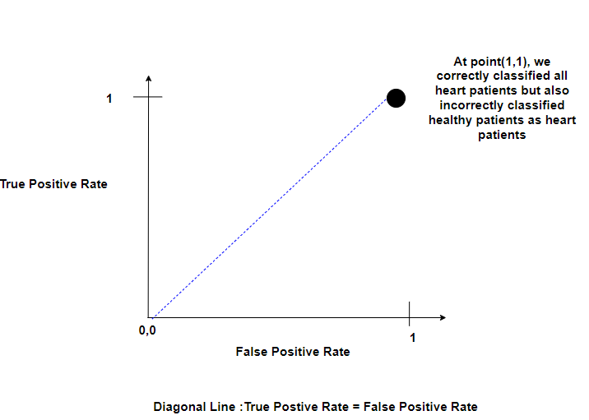
Understanding AUC: Use Case
Threshold classifying all people as having heart disease

Slide 31
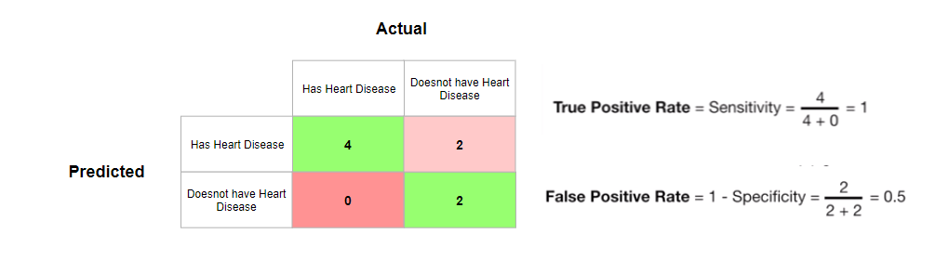
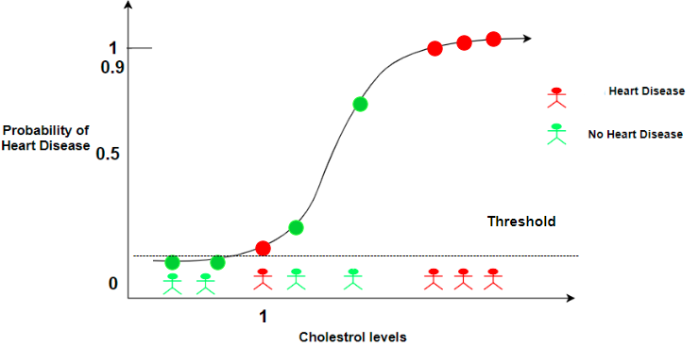
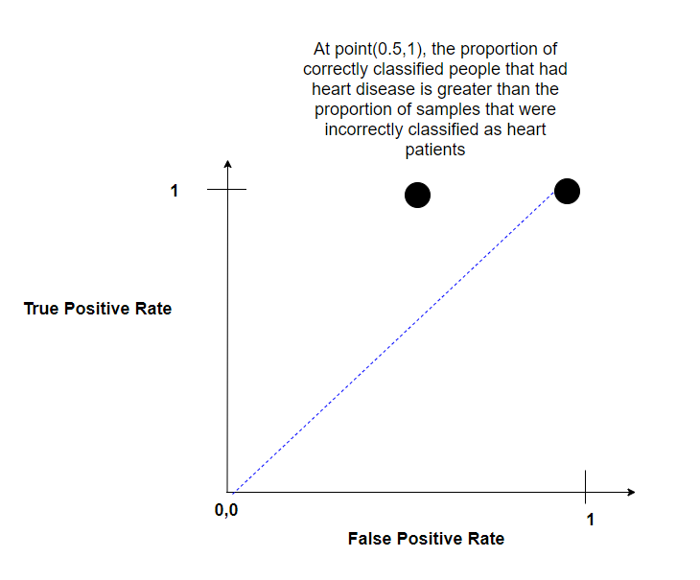
Understanding AUC: Use Case
Increasing the Threshold slightly so that only the two people with the least cholesterol value are below the threshold.

Slide 32
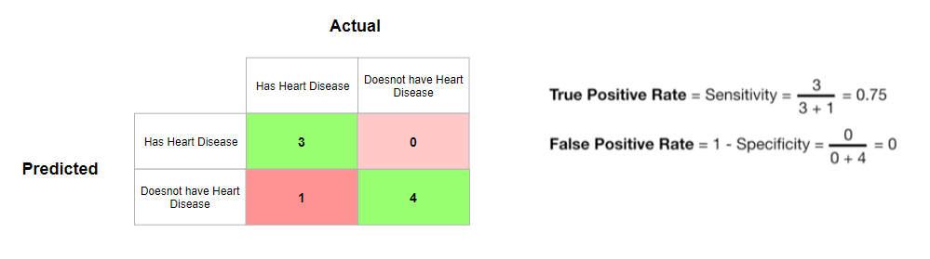
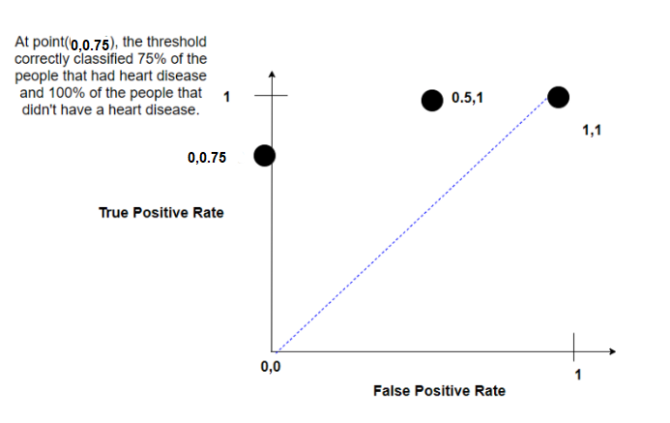
Understanding AUC: Use Case
Threshold= 0.75

Slide 33
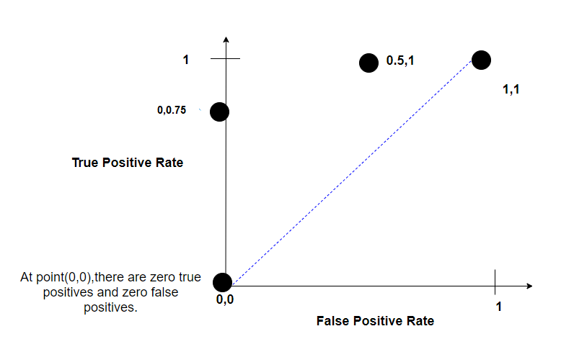
Understanding AUC: Use Case
Threshold= 1 : classify all people as not having a heart disease

Slide 34
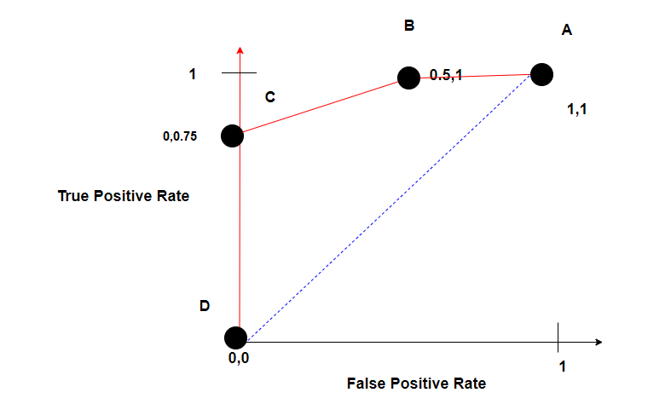
Understanding AUC: Use Case
ROC graph

Slide 35
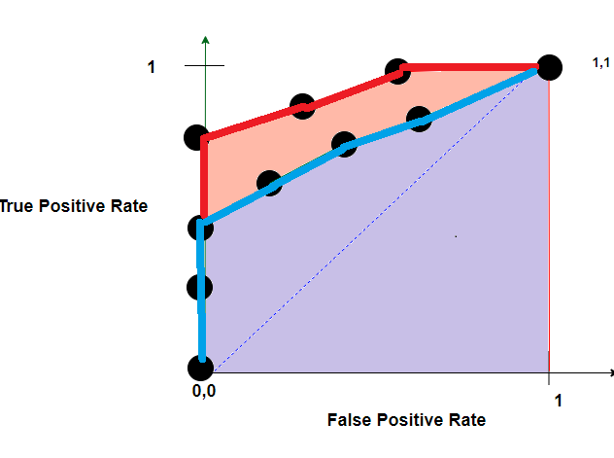
Understanding AUC: Use Case
The AUC for the red ROC curve is greater than the AUC for the blue ROC curve. This means that the Red curve is better.

Slide 36
More Examples
A random sample of 500 teenagers. Of these teenagers, 50 actually are Covid-positive. I predicted 100 total covid-positive teenagers, 45 of which are actually positive.

Slide 37
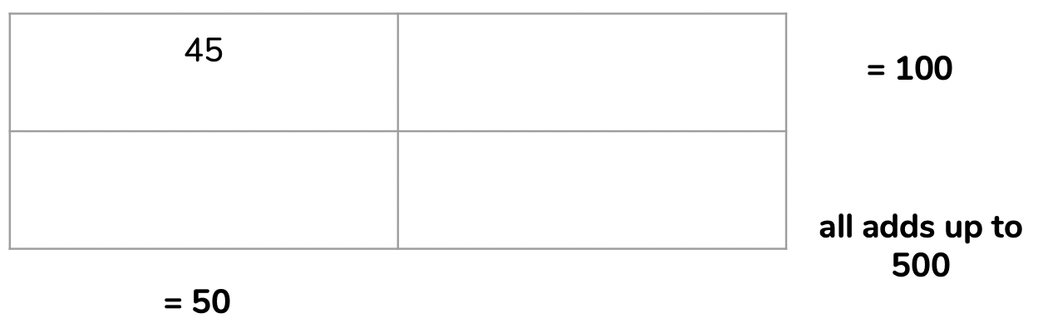
More Examples
A random sample of 500 teenagers. Of these teenagers, 50 actually are Covid-positive. I predicted 100 total covid-positive teenagers, 45 of which are actually positive.
Actual
Positive Not
Actual
Positive Not

Slide 38
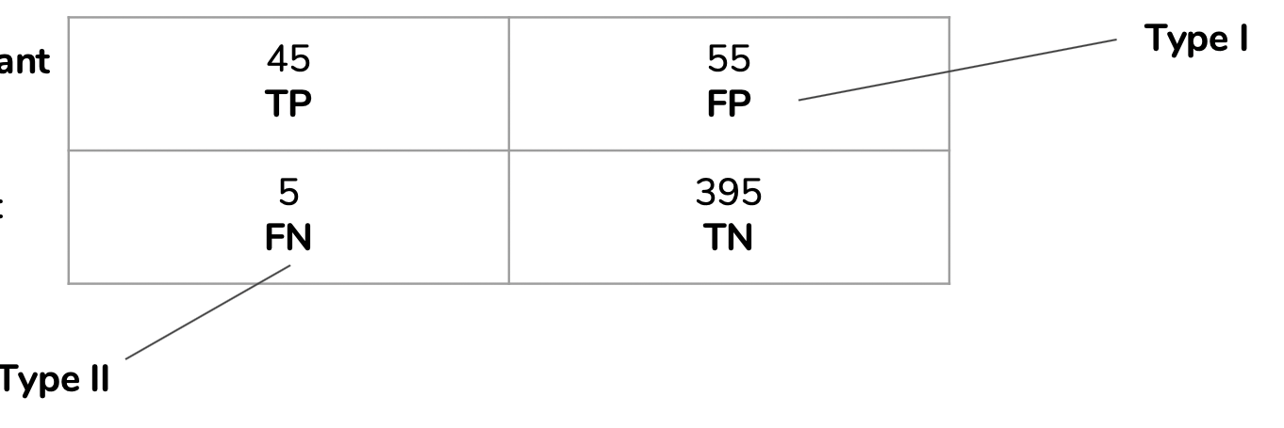
More Examples
A random sample of 500 teenagers. Of these teenagers, 50 actually are Covid-positive. I predicted 100 total covid-positive teenagers, 45 of which are actually positive.
Actual
Positive Not
Actual
Positive Not

Slide 39
More Examples
Actual
Positive Not
Actual
Positive Not
Accuracy (all correct / all) = TP + TN / TP + TN + FP + FN
(45 + 395) / 500 = 440 / 500 = 0.88 or 88% Accuracy
Misclassification (all incorrect / all) = FP + FN / TP + TN + FP + FN
(55 + 5) / 500 = 60 / 500 = 0.12 or 12% Misclassification

Slide 40
More Examples
Actual
Positive Not
Actual
Positive Not
Precision (true positives / predicted positives) = TP / TP + FP
45 / (45 + 55) = 45 / 100 = 0.45 or 45% Precision

Slide 41
More Examples
Actual
Positive Not
Actual
Positive Not
Sensitivity/Recall (true positives / all actual positives) = TP / TP + FN
45 / (45 + 5) = 45 / 50 = 0.90 or 90% Sensitivity

Slide 42
More Examples
Actual
Positive Not
Actual
Positive Not
Specificity (true negatives / all actual negatives) =TN / TN + FP
395 / (395 + 55) = 395 / 450 = 0.88 or 88% Specificity

Slide 43
THANK YOU

